Slide 1
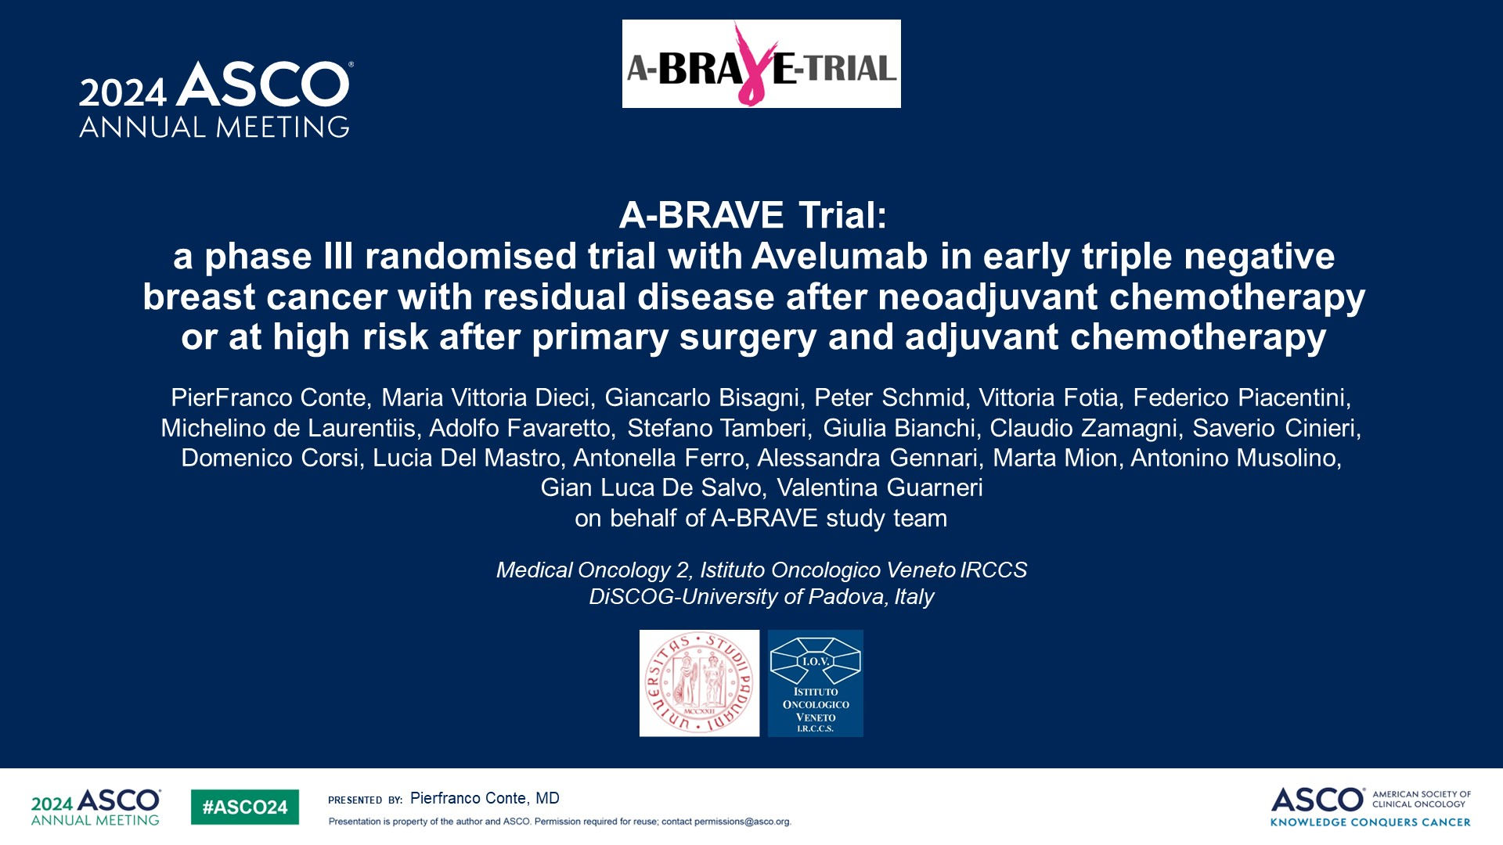
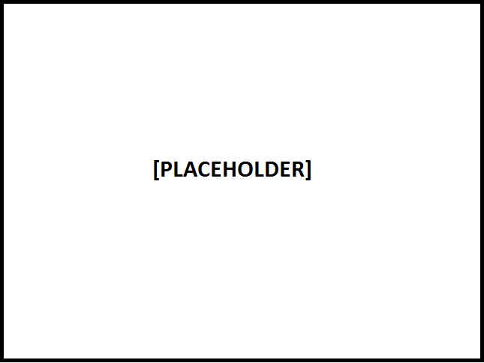
A-BRAVE Trial: <br />a phase III randomised trial with Avelumab in early triple negative breast cancer with residual disease after neoadjuvant chemotherapy or at high risk after primary surgery and adjuvant chemotherapy
Content of this presentation is the property of the author, licensed by ASCO. Permission required for reuse.

Slide 2
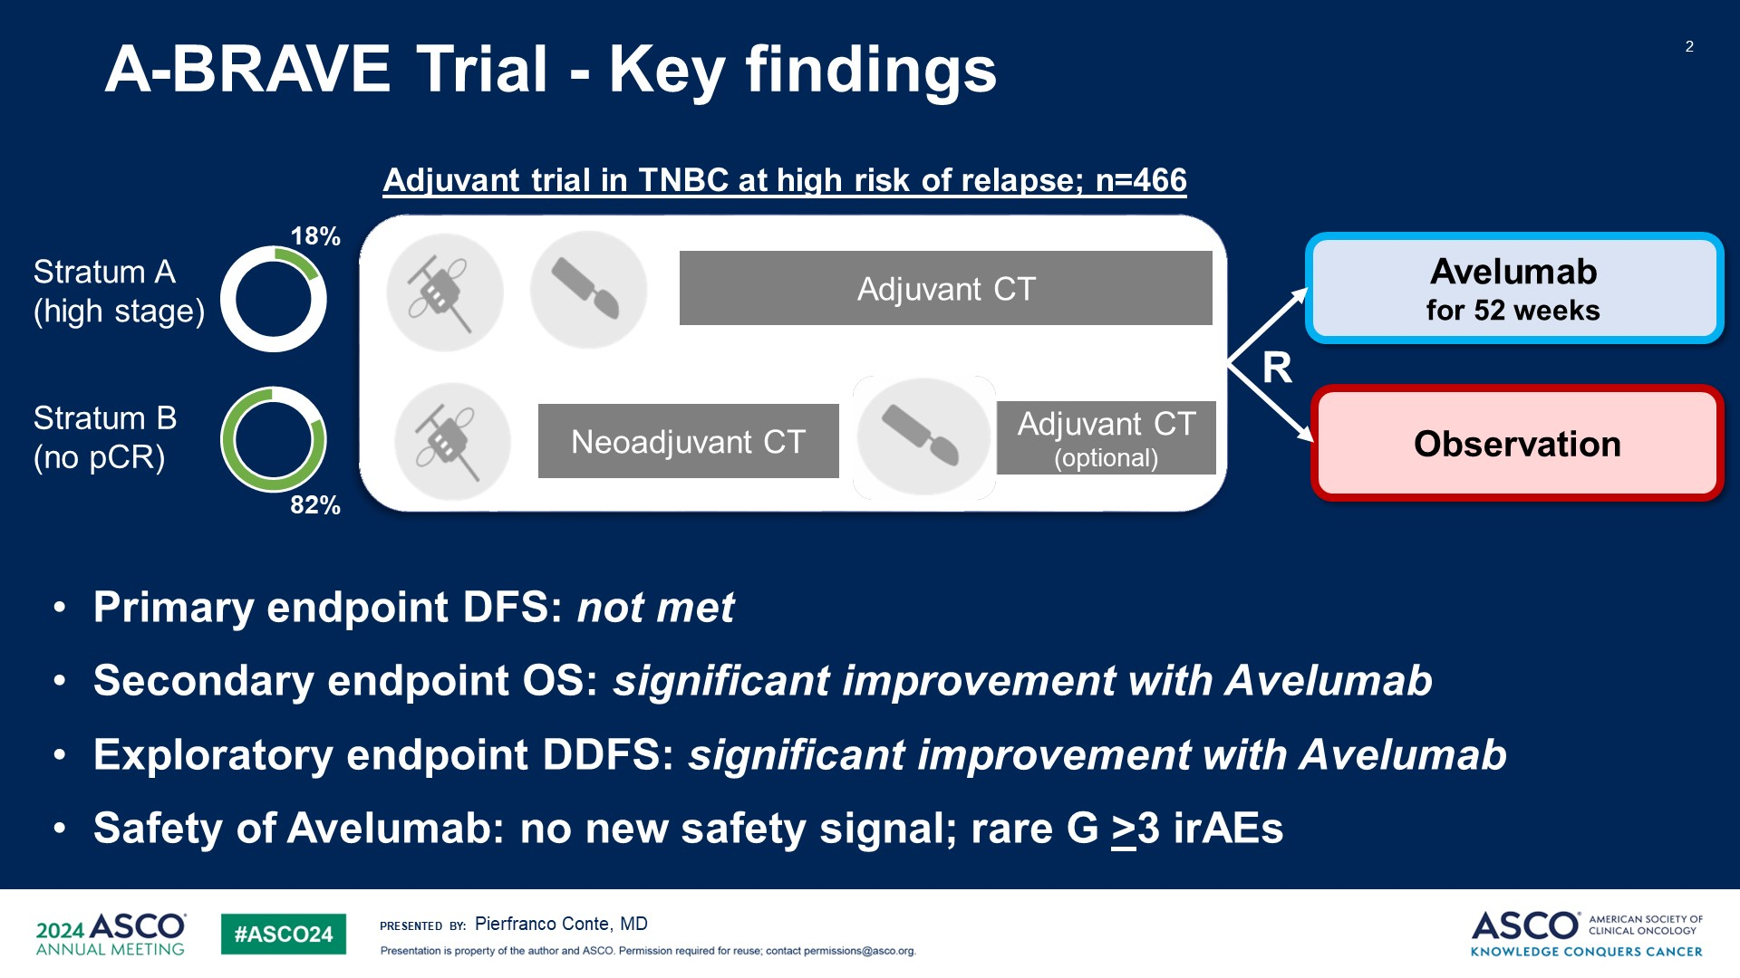
A-BRAVE Trial - Key findings
Content of this presentation is the property of the author, licensed by ASCO. Permission required for reuse.

Slide 3
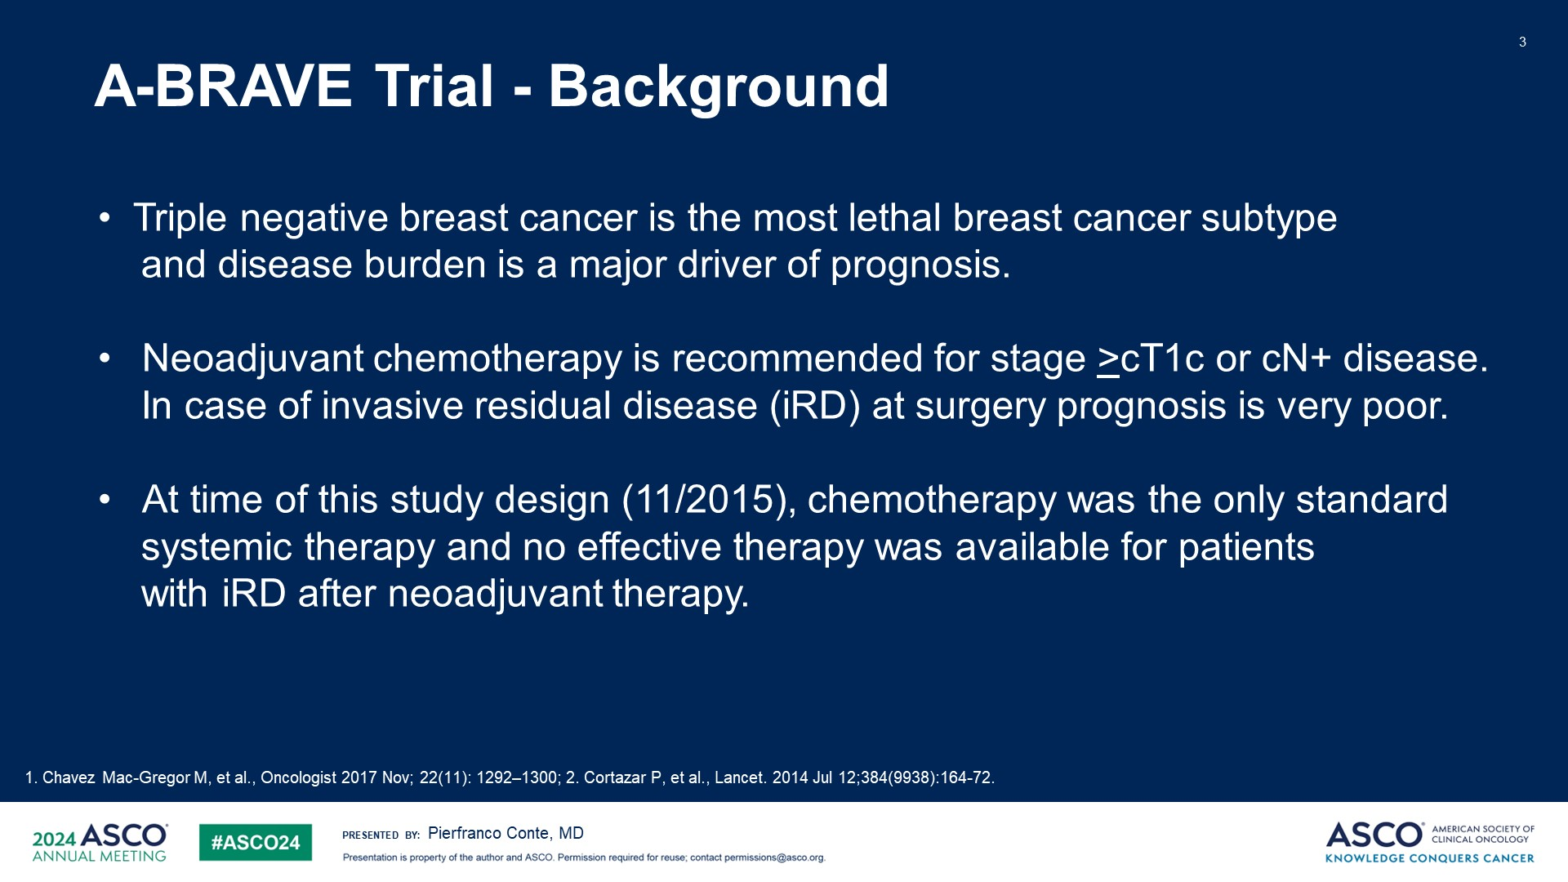
Slide 3
Content of this presentation is the property of the author, licensed by ASCO. Permission required for reuse.

Slide 4
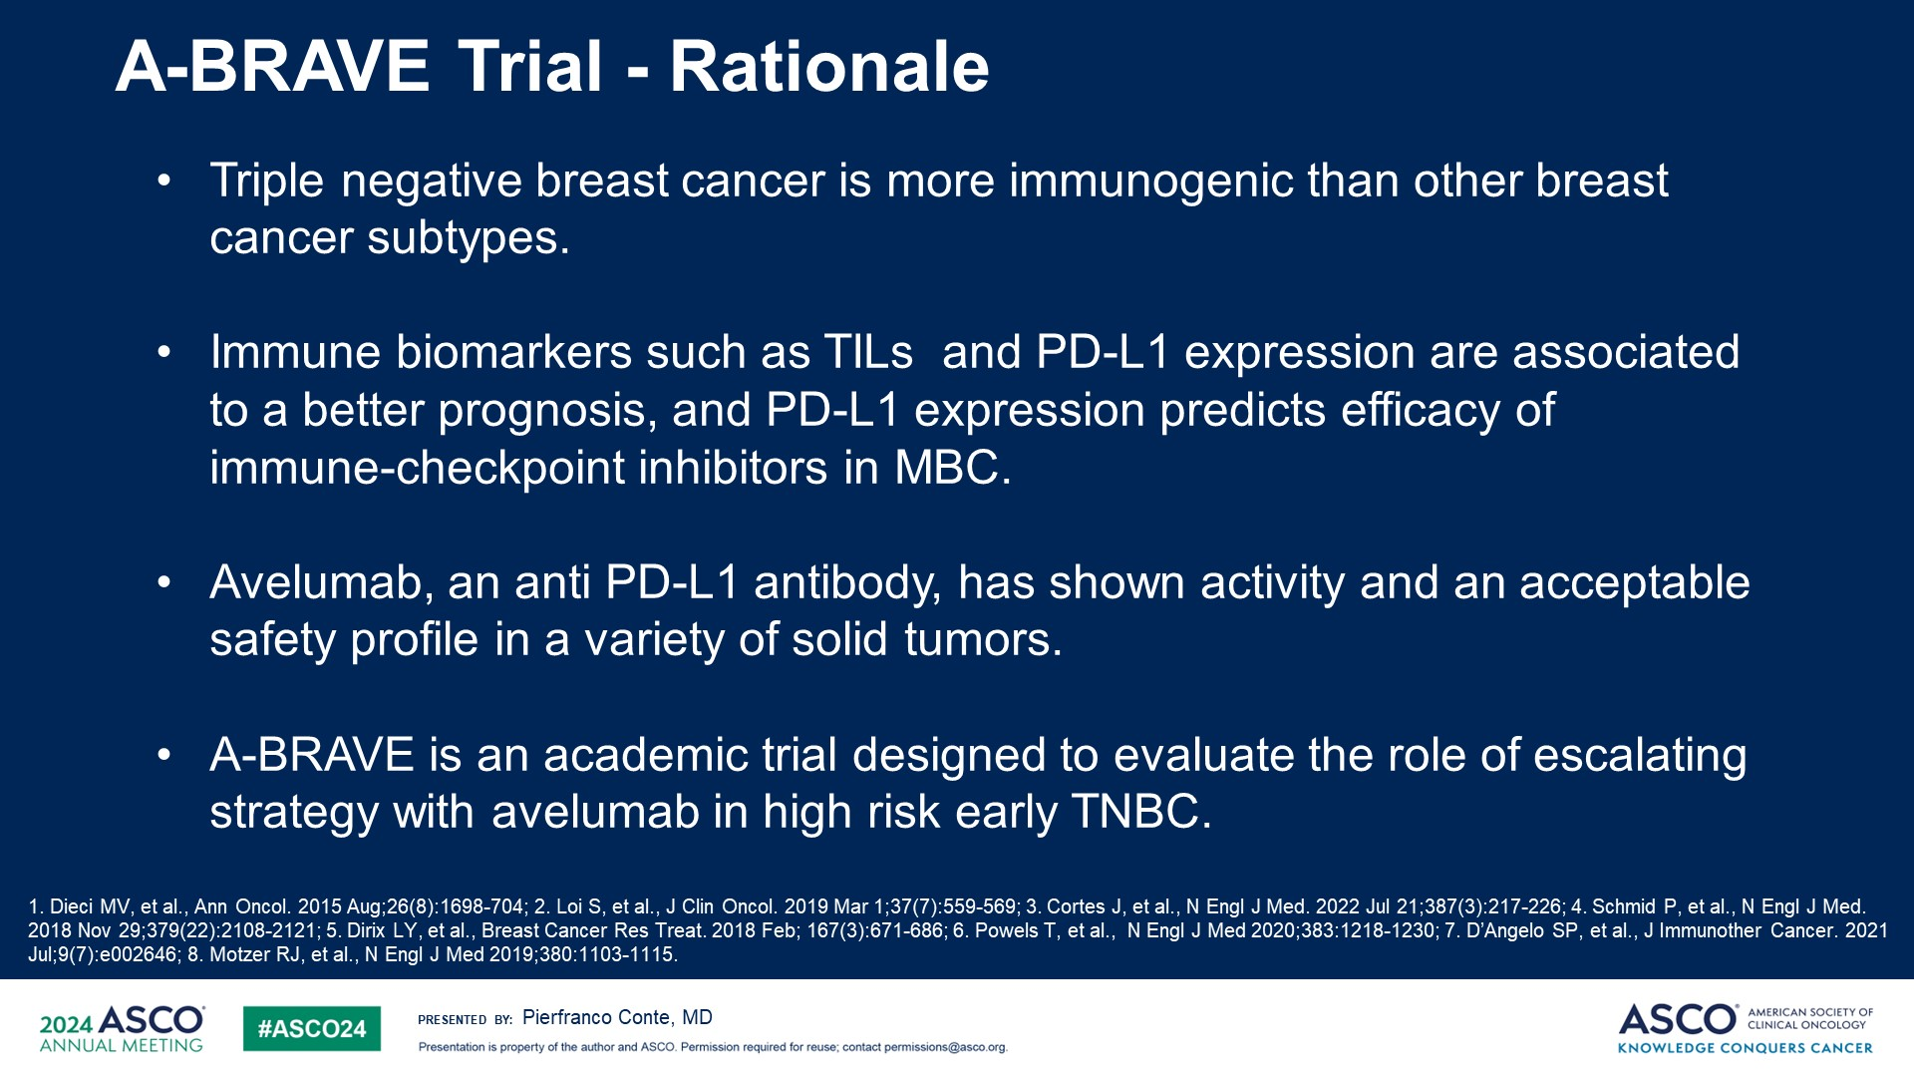
Slide 4
Content of this presentation is the property of the author, licensed by ASCO. Permission required for reuse.

Slide 5
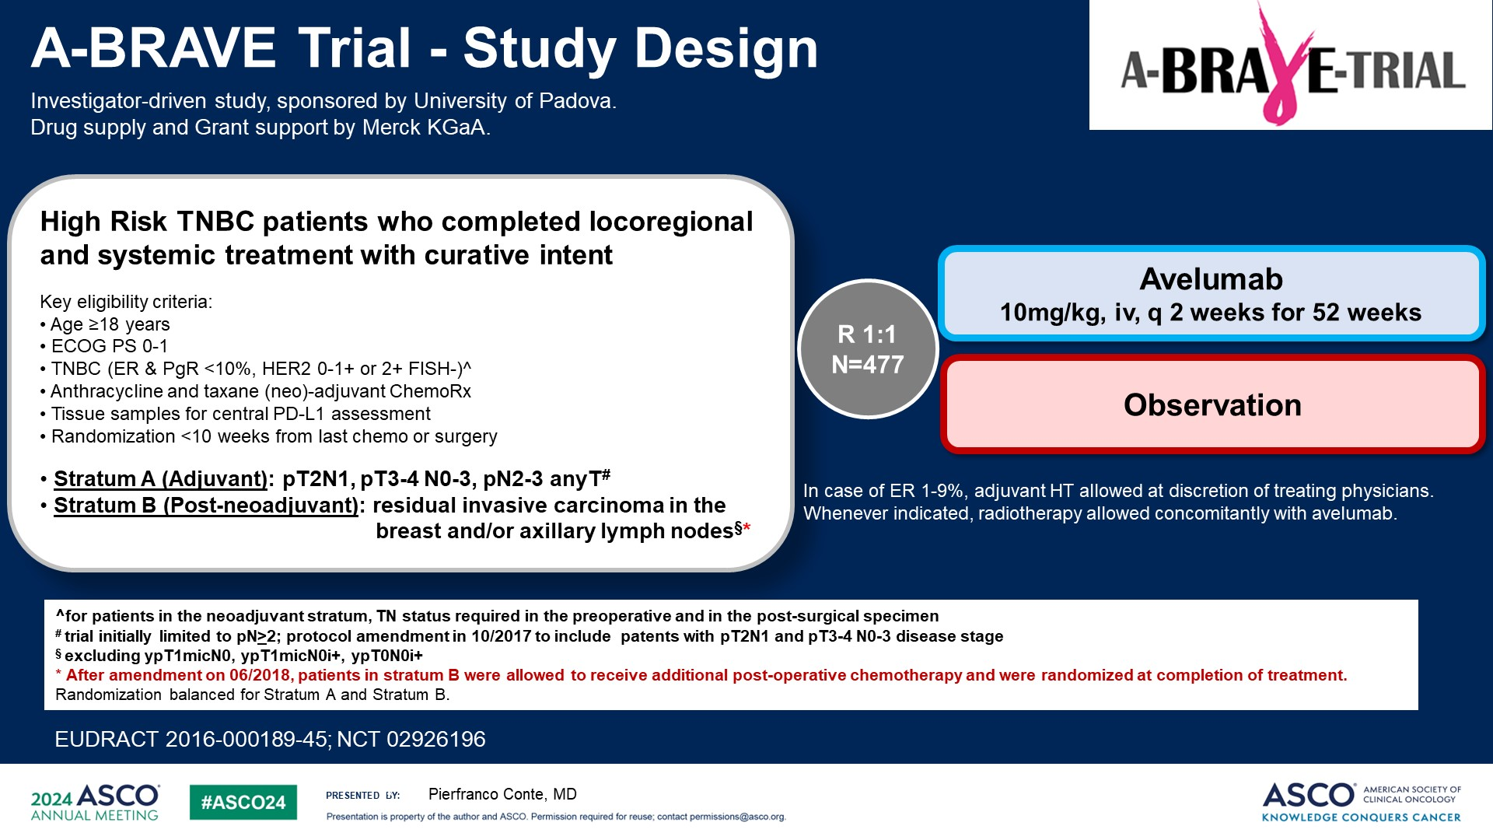
A-BRAVE Trial - Study Design
Content of this presentation is the property of the author, licensed by ASCO. Permission required for reuse.

Slide 6
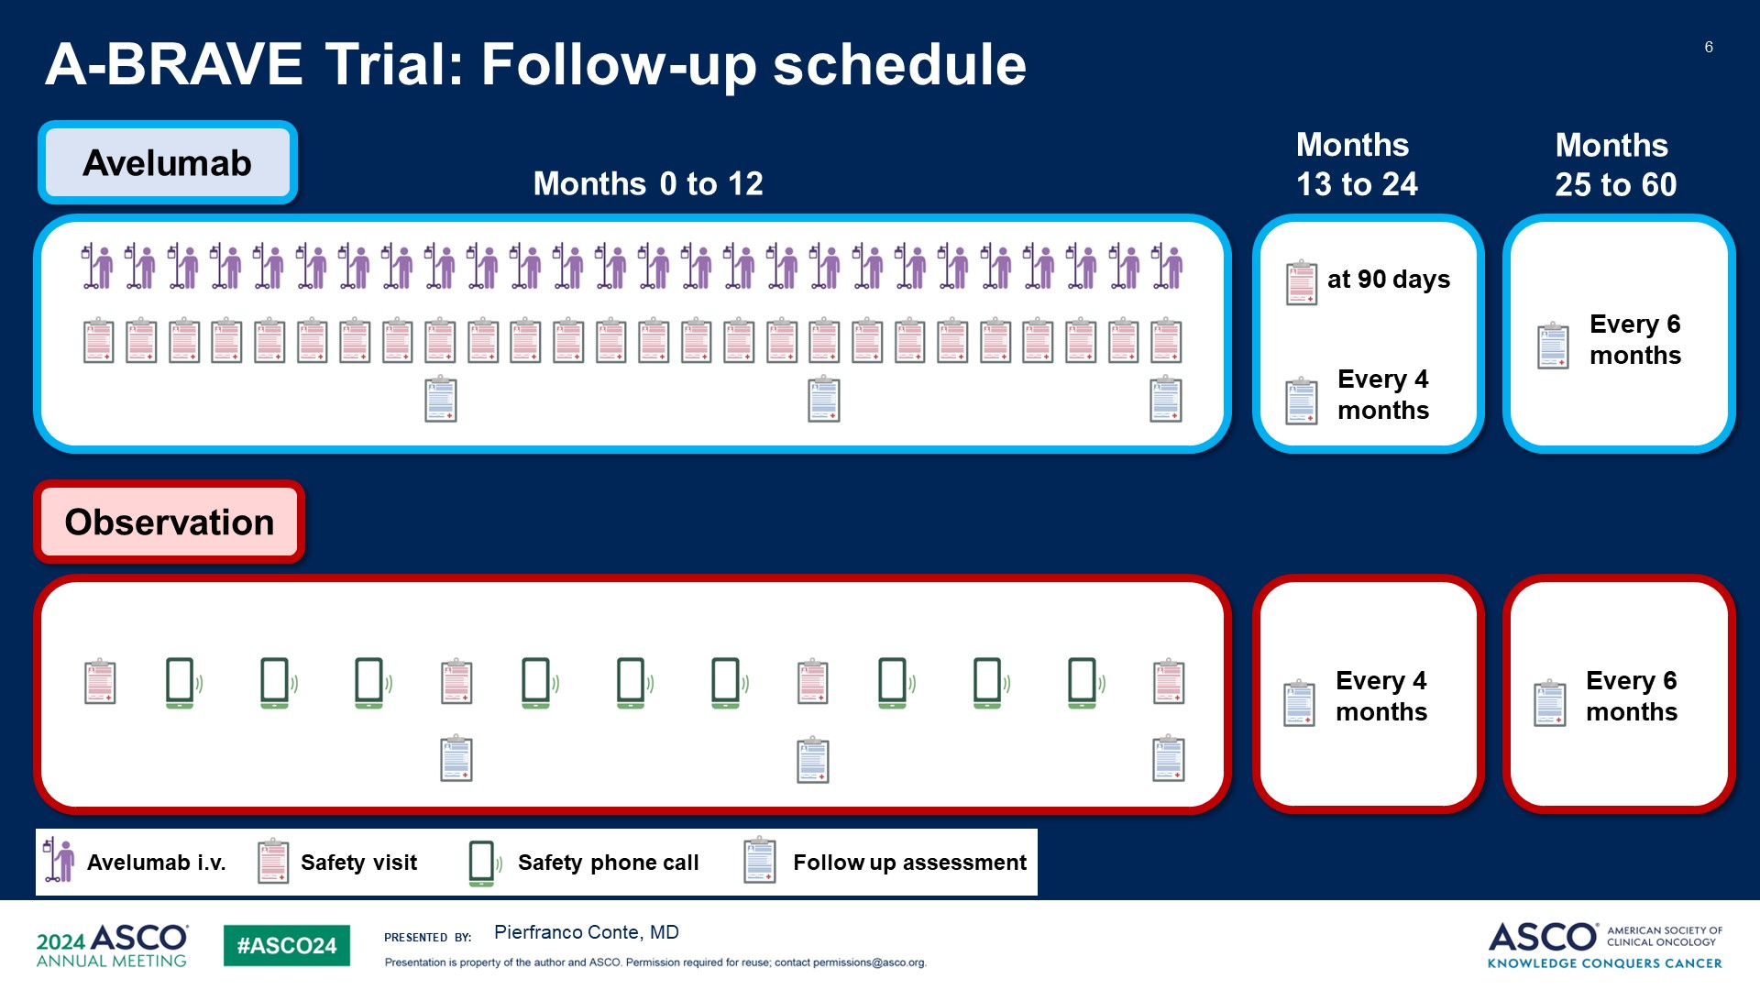
Slide 6
Content of this presentation is the property of the author, licensed by ASCO. Permission required for reuse.

Slide 7
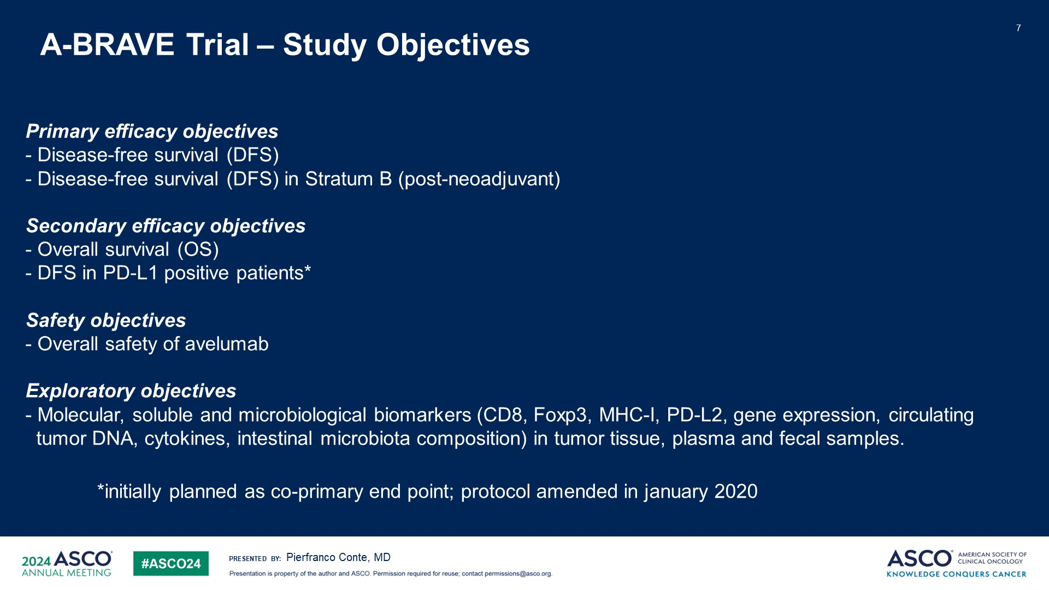
A-BRAVE Trial – Study Objectives
Content of this presentation is the property of the author, licensed by ASCO. Permission required for reuse.

Slide 8
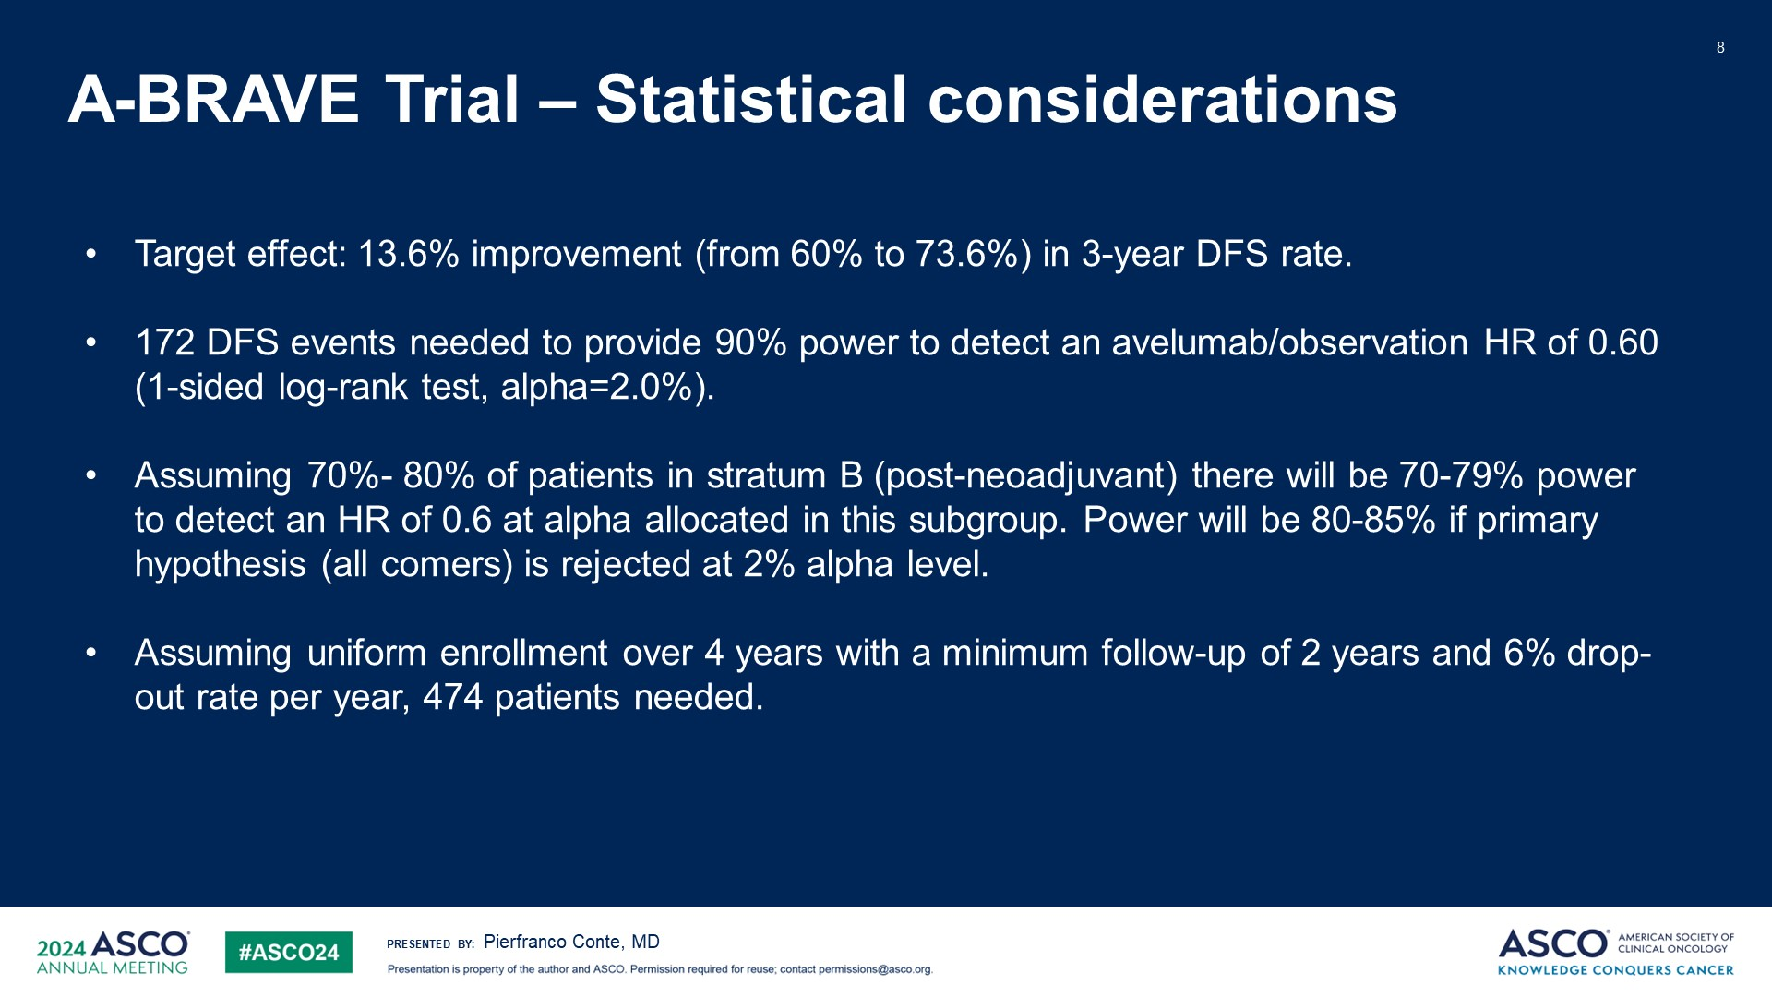
Slide 8
Content of this presentation is the property of the author, licensed by ASCO. Permission required for reuse.

Slide 9
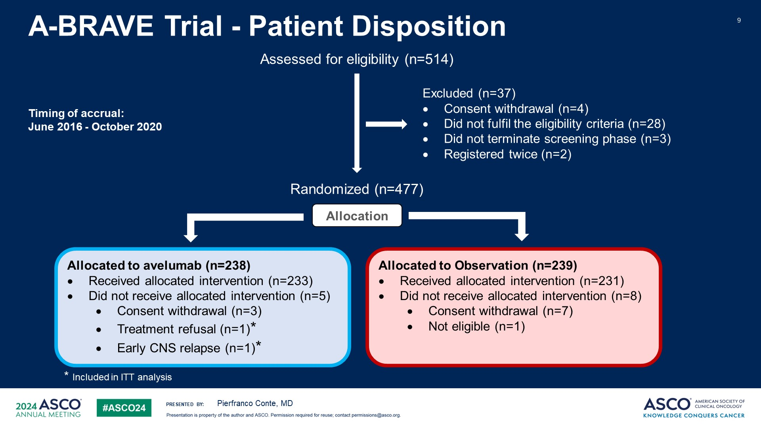
Slide 9
Content of this presentation is the property of the author, licensed by ASCO. Permission required for reuse.

Slide 10
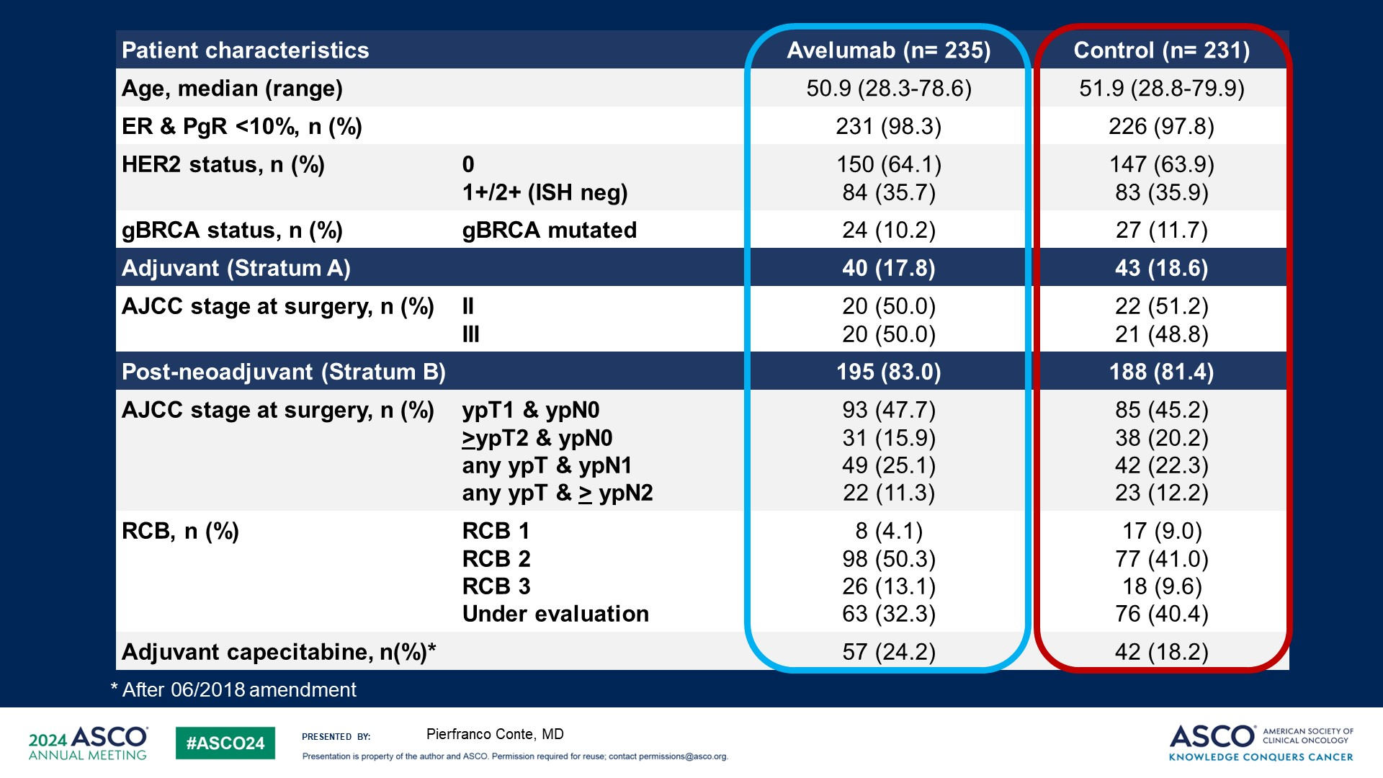
Slide 10
Content of this presentation is the property of the author, licensed by ASCO. Permission required for reuse.

Slide 11
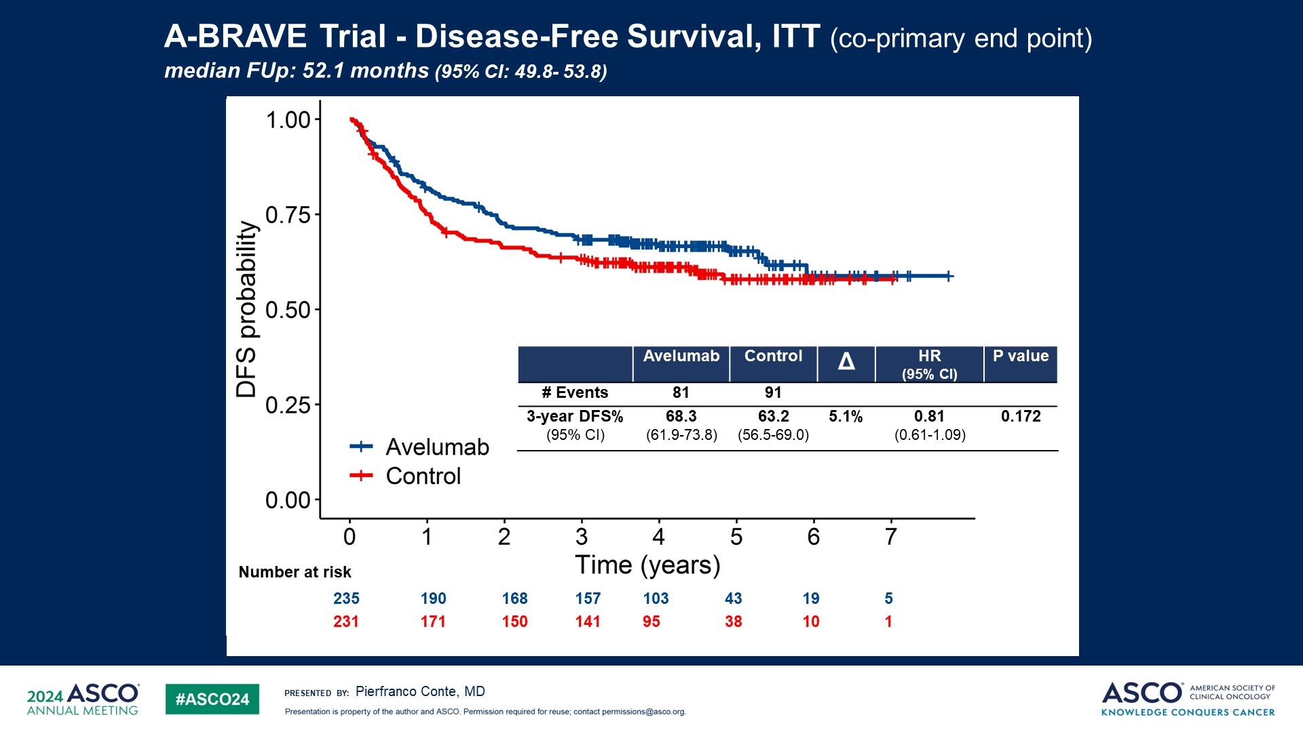
A-BRAVE Trial - Disease-Free Survival, ITT (co-primary end point) <br />median FUp: 52.1 months (95% CI: 49.8- 53.8)
Content of this presentation is the property of the author, licensed by ASCO. Permission required for reuse.

Slide 12
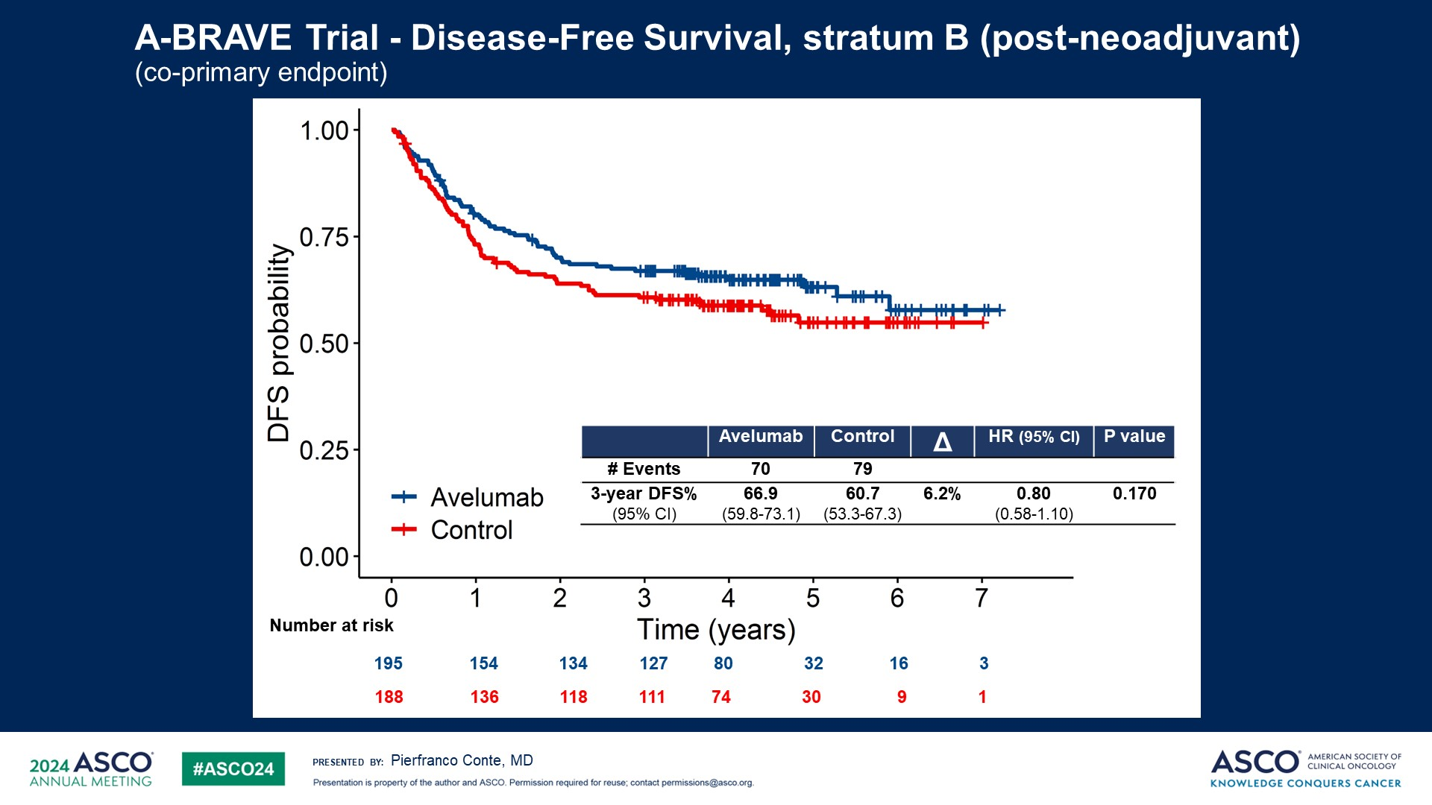
A-BRAVE Trial - Disease-Free Survival, stratum B (post-neoadjuvant) <br />(co-primary endpoint)
Content of this presentation is the property of the author, licensed by ASCO. Permission required for reuse.

Slide 13
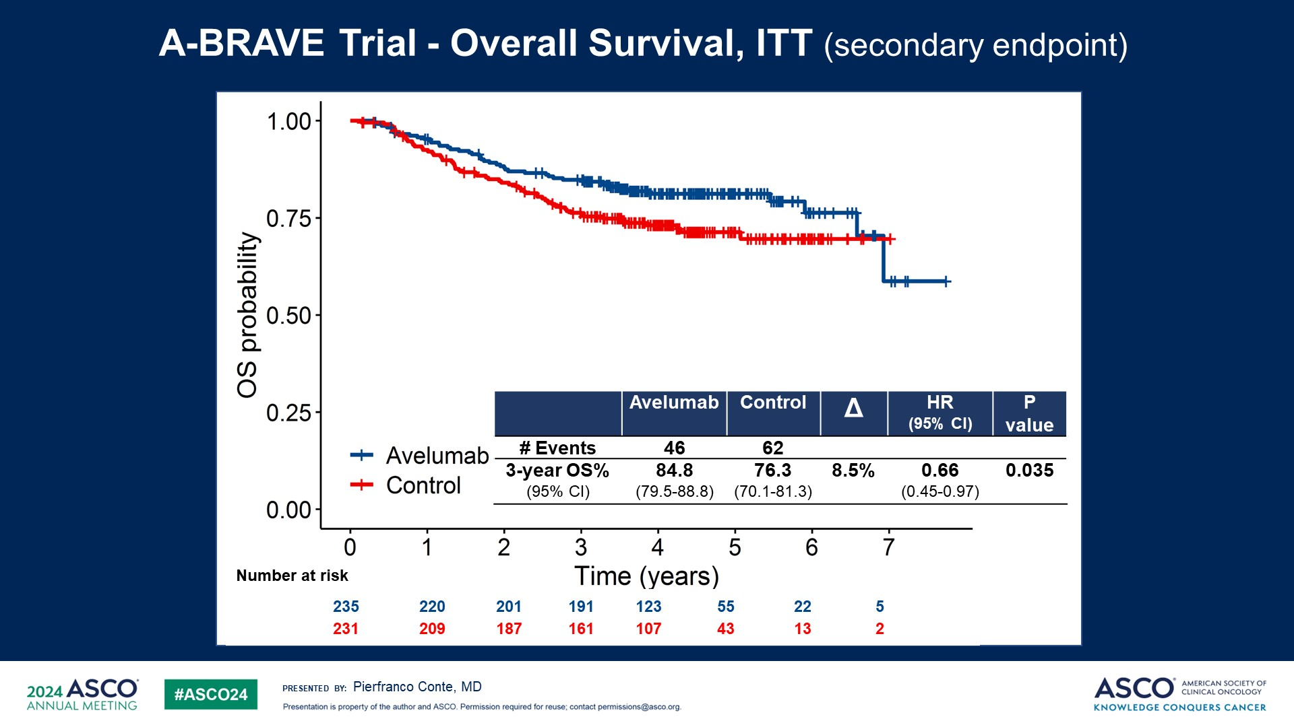
A-BRAVE Trial - Overall Survival, ITT (secondary endpoint)
Content of this presentation is the property of the author, licensed by ASCO. Permission required for reuse.

Slide 14
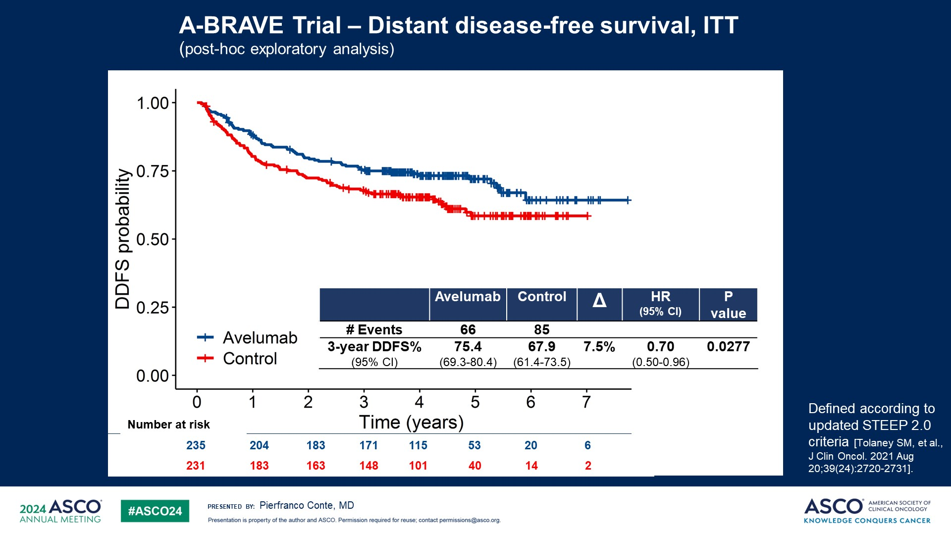
A-BRAVE Trial – Distant disease-free survival, ITT<br />(post-hoc exploratory analysis)
Content of this presentation is the property of the author, licensed by ASCO. Permission required for reuse.

Slide 15
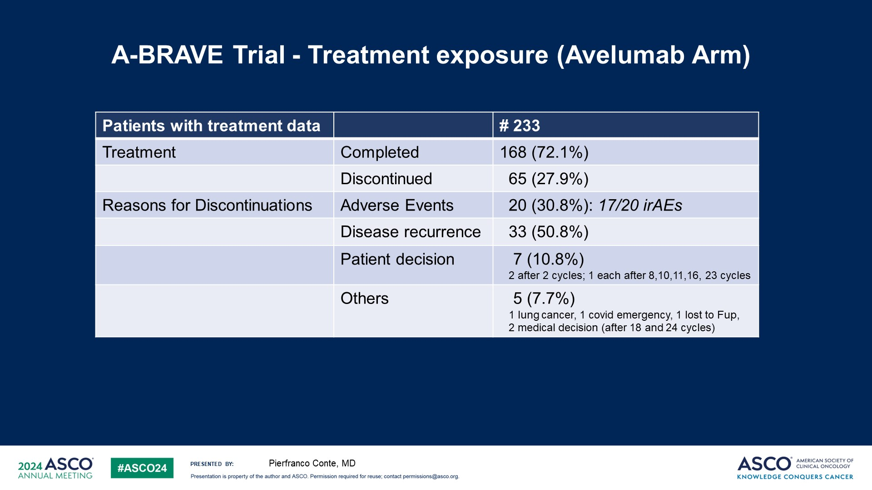
Slide 15
Content of this presentation is the property of the author, licensed by ASCO. Permission required for reuse.

Slide 16
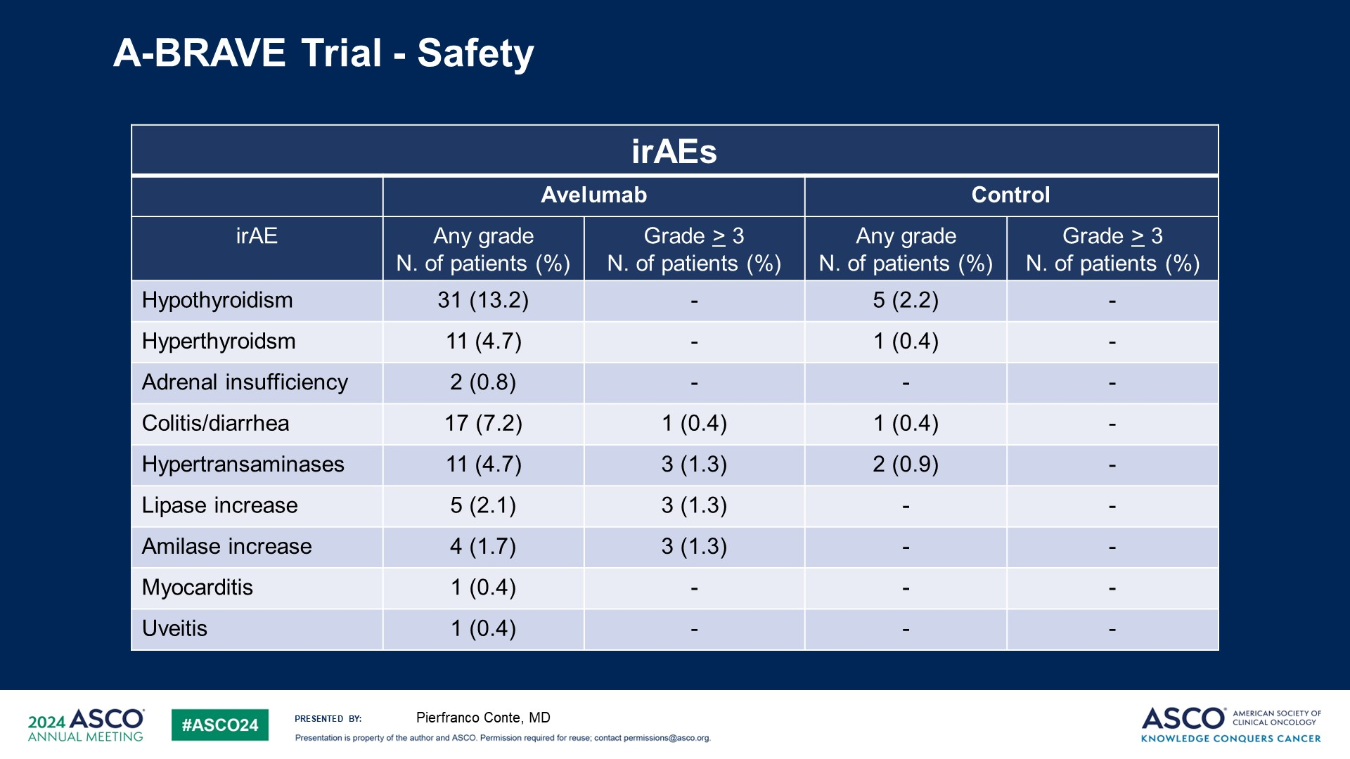
Slide 16
Content of this presentation is the property of the author, licensed by ASCO. Permission required for reuse.

Slide 17
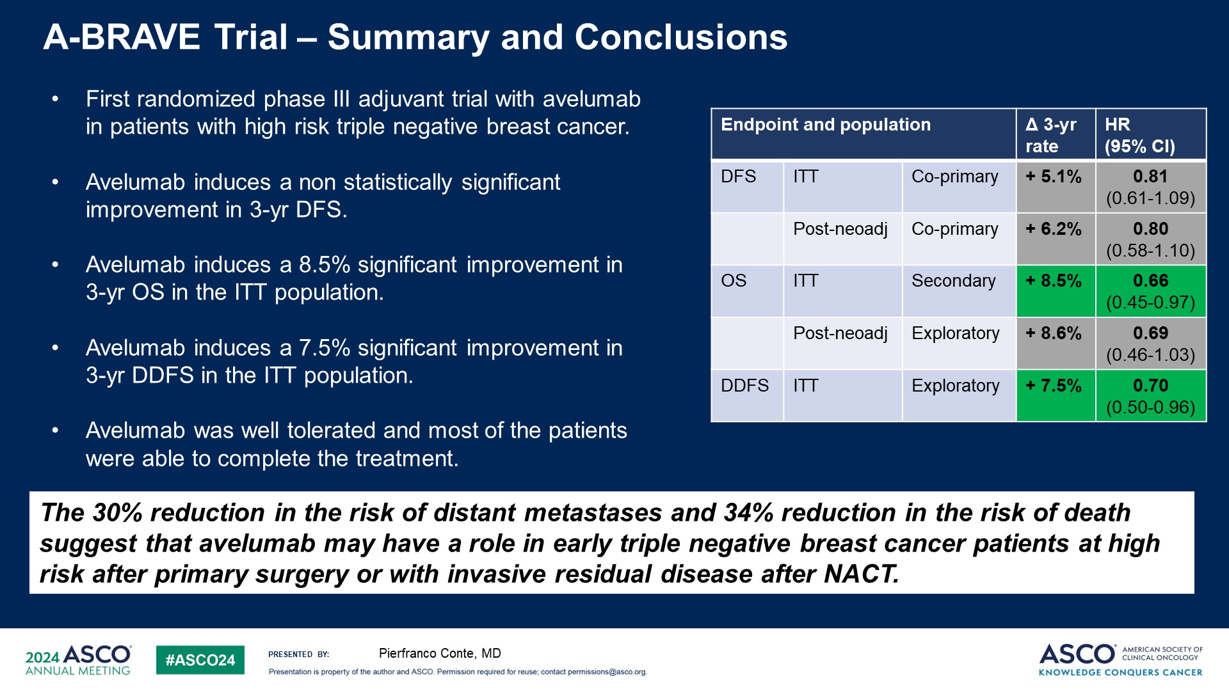
A-BRAVE Trial – Summary and Conclusions
Content of this presentation is the property of the author, licensed by ASCO. Permission required for reuse.

Slide 18
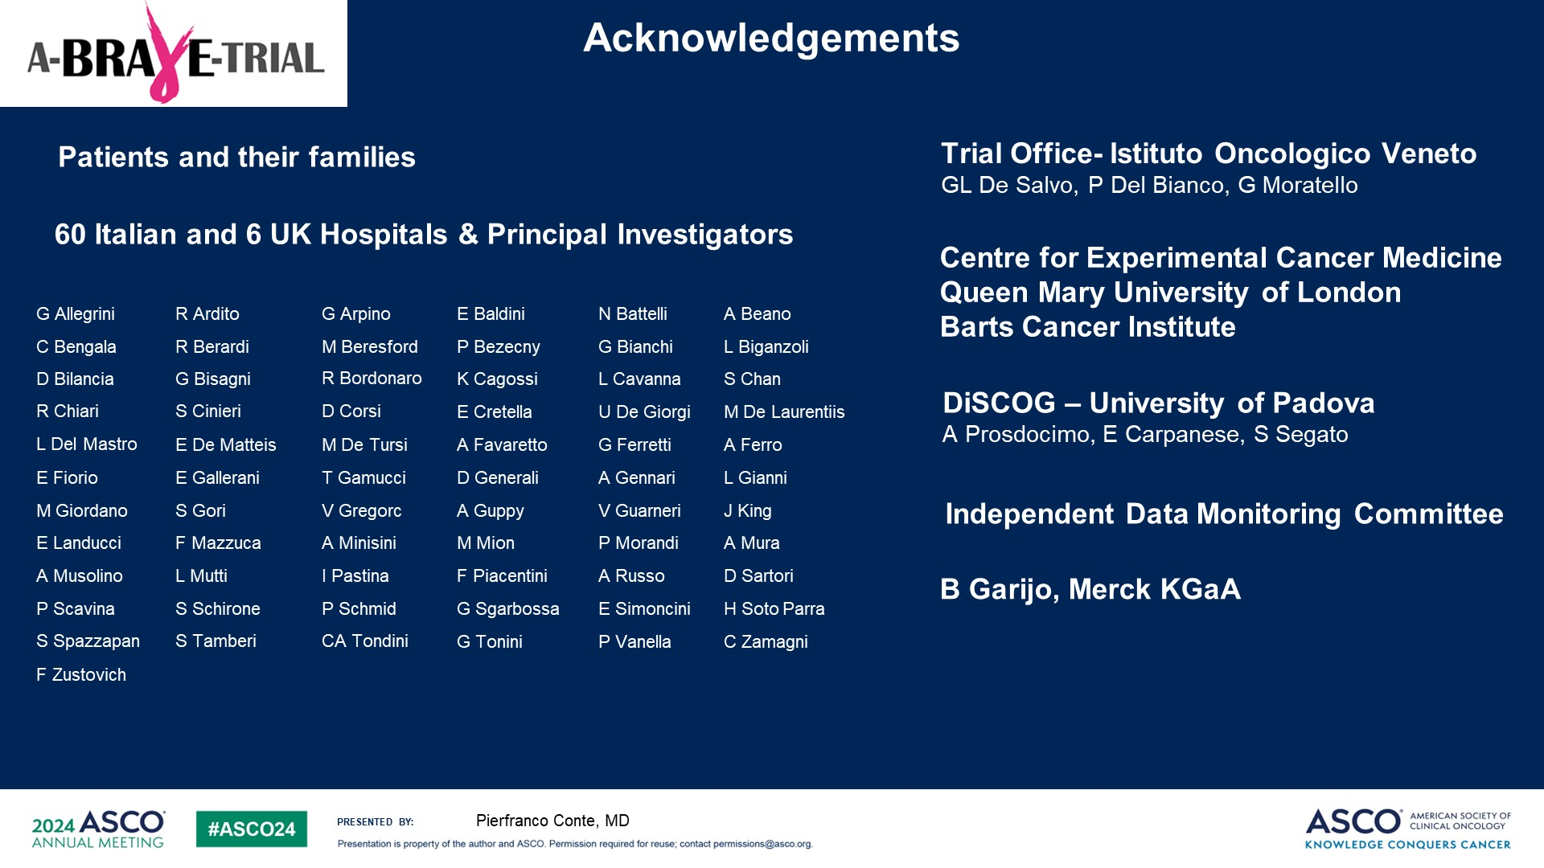
Acknowledgements
Content of this presentation is the property of the author, licensed by ASCO. Permission required for reuse.

